Slide 1
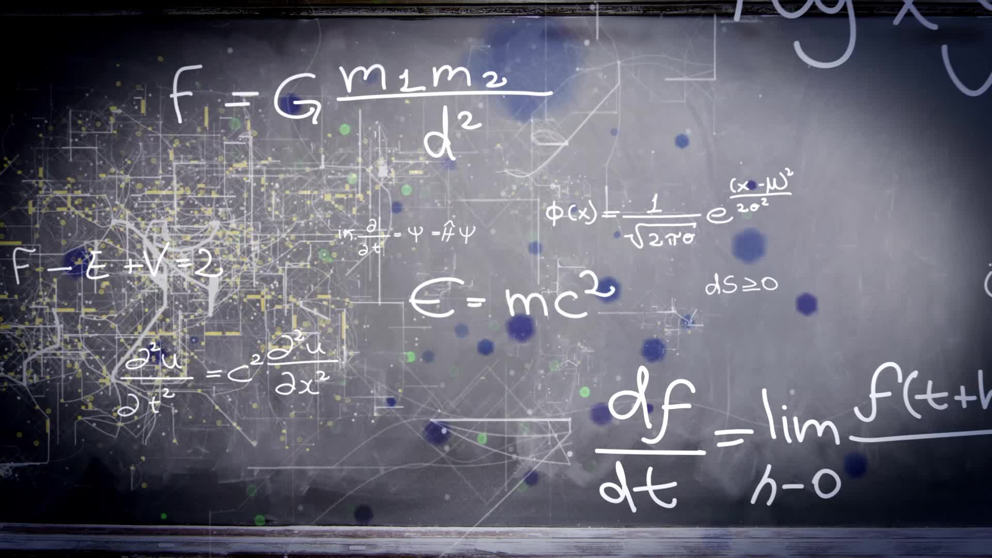
Chapter 1.5:
Infinite Limits
HONORS CALCULUS/CALCULUS

Slide 2
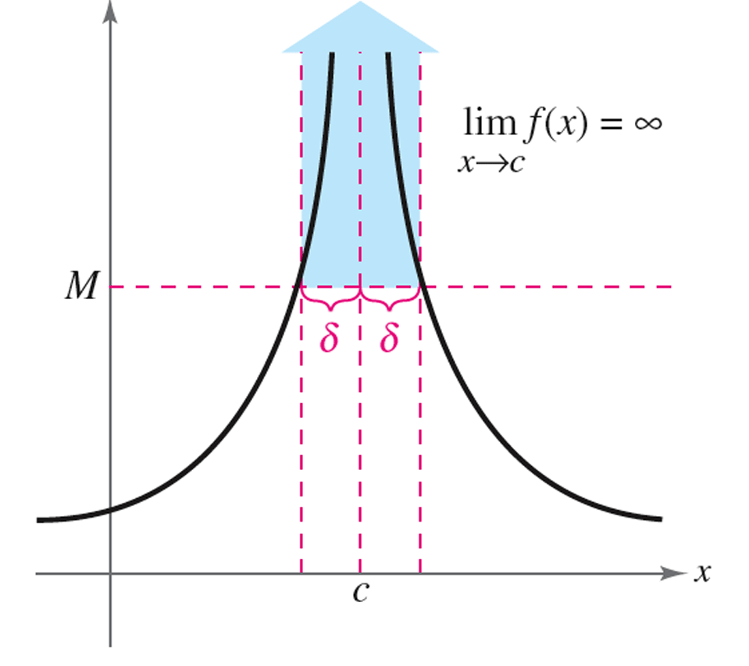
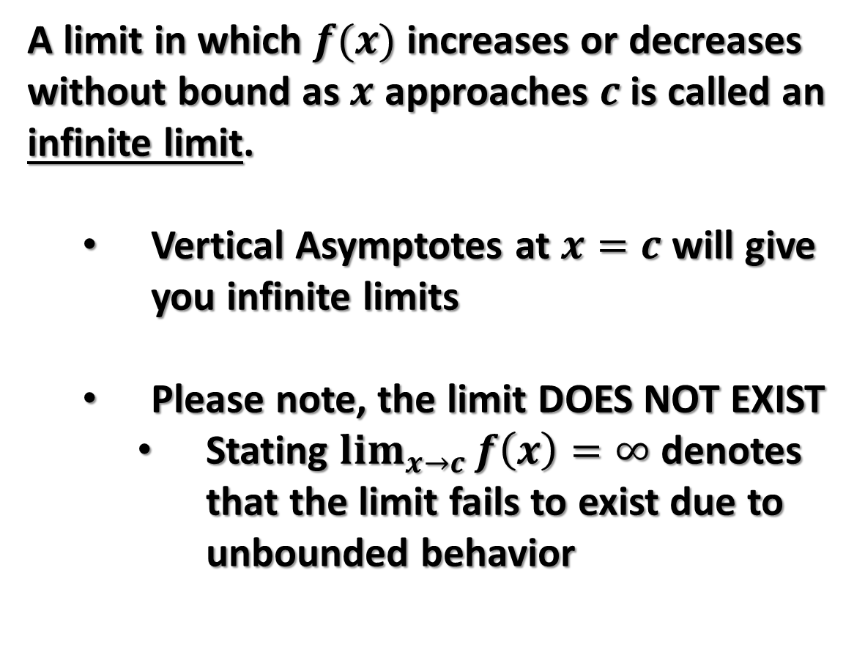
Infinite Limits
A limit in which $f(x)$ increases or decreases without bound as $x$ approaches $c$ is called an infinite limit.
  Vertical Asymptotes at $x=c$ will give you infinite limits
  Please note, the limit DOES NOT EXIST
    Stating $\lim_{x→c}{f\left(x\right)=∞}$ denotes that the limit fails to exist due to unbounded behavior

Slide 3
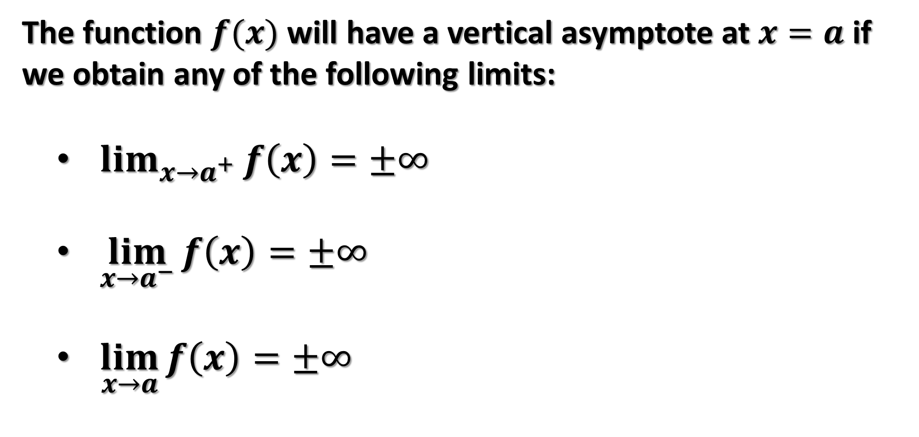
Infinite Limits
The function $f(x)$ will have a vertical asymptote at $x=a$ if we obtain any of the following limits:
  $\lim_{x→a^{+}}{f\left(x\right)=±∞}$
  $\lim_{x→a^{−}}{f\left(x\right)=±∞}$
  $\lim_{x→a}{f\left(x\right)=±∞}$

Slide 4
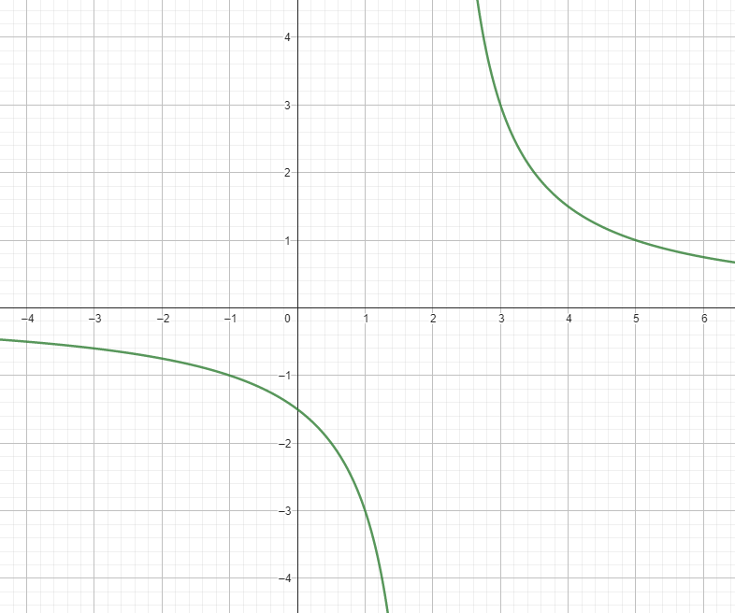













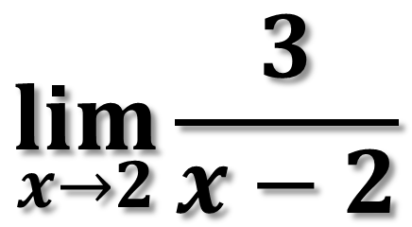



Ex. 1)
$$\lim_{x→2}{\frac{3}{x−2}}$$

Slide 5
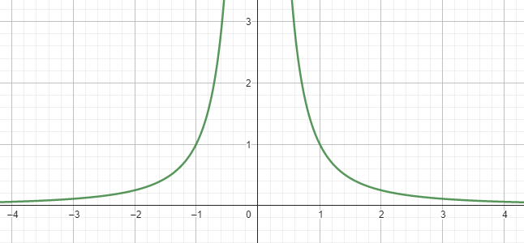




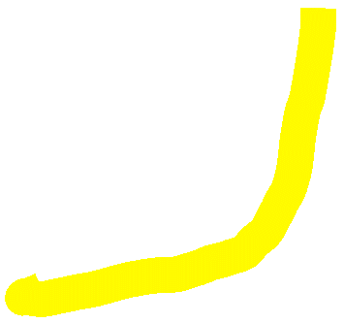




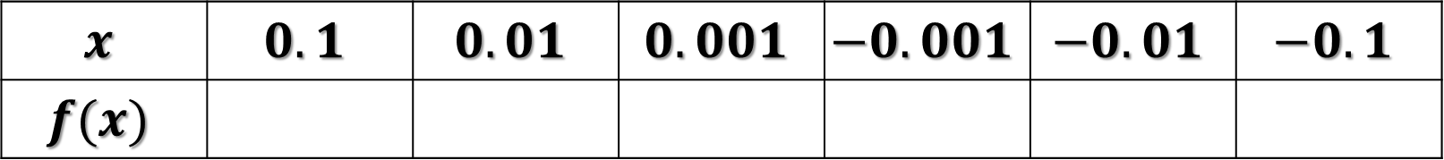


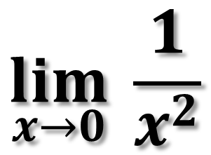




Ex. 2)
$$\lim_{x→0}{ \frac{1}{x^{2}}}$$
$$x$$ | $$0.1$$ | $$0.01$$ | $$0.001$$ | $$−0.001$$ | $$−0.01$$ | $$−0.1$$
$$f(x)$$

Slide 6

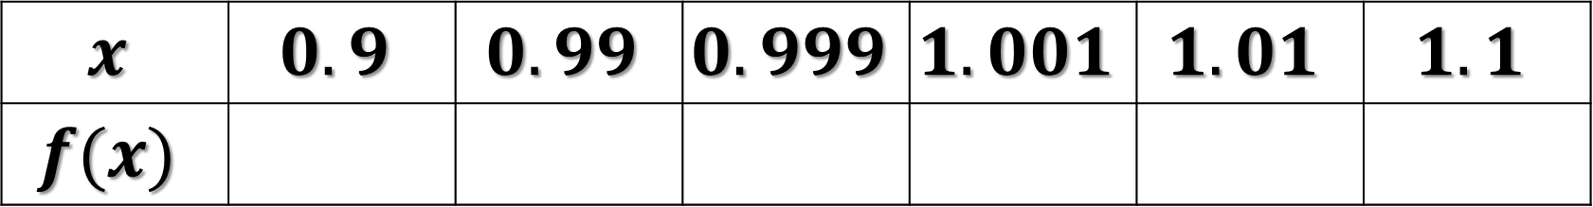

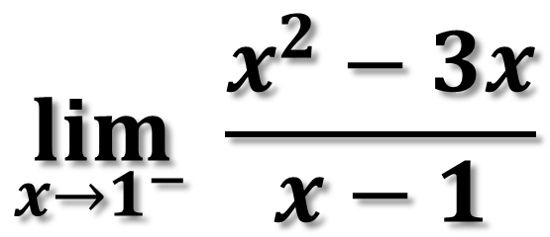
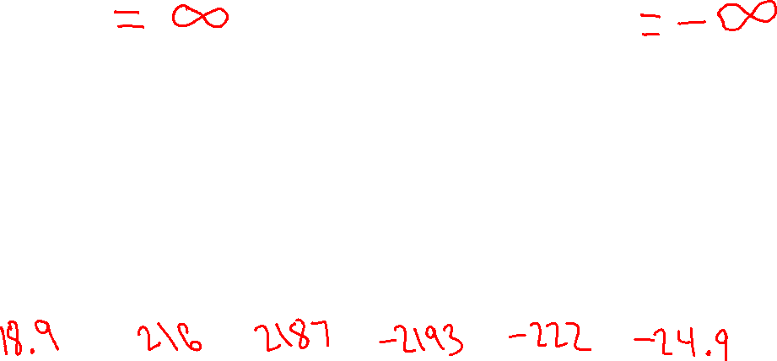

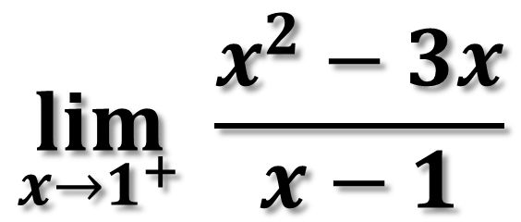

Ex. 3)
$$\lim_{x→1^{−}}{ \frac{x^{2}−3x}{x−1}}$$
$$\lim_{x→1^{+}}{ \frac{x^{2}−3x}{x−1}}$$
$$x$$ | $$0.9$$ | $$0.99$$ | $$0.999$$ | $$1.001$$ | $$1.01$$ | $$1.1$$
$$f(x)$$

Slide 7





















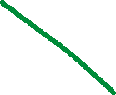






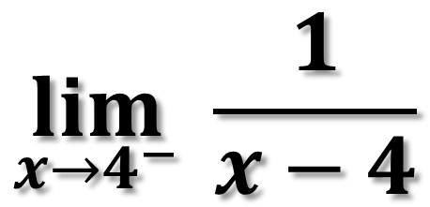

Ex. 4)
$$\lim_{x→4^{−}}{ \frac{1}{x−4}}$$

Slide 8


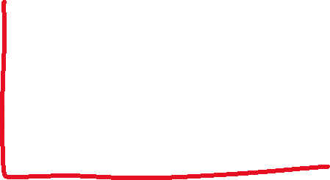


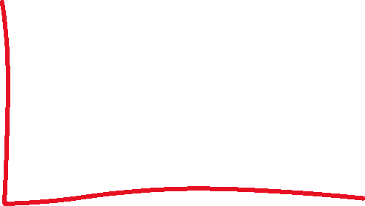









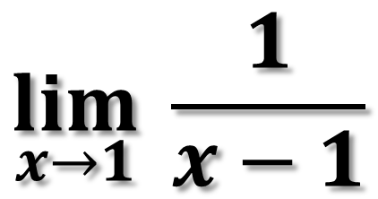



Ex. 5)
$$\lim_{x→1}{ \frac{1}{x−1}}$$

Slide 9
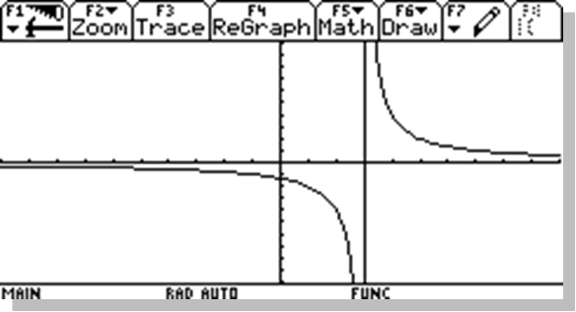
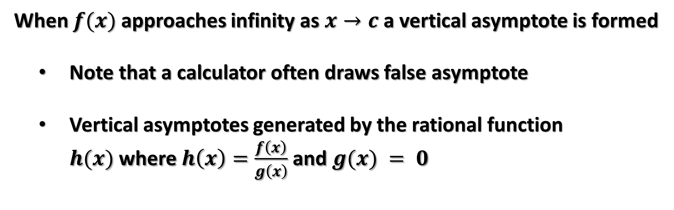
Vertical Asymptotes
When $f(x)$ approaches infinity as $x→c$ a vertical asymptote is formed
  Note that a calculator often draws false asymptote
  Vertical asymptotes generated by the rational function $h(x)$where $h\left(x\right)=\frac{f\left(x\right)}{g\left(x\right)}$ and$g(x) = 0$
c

Slide 10
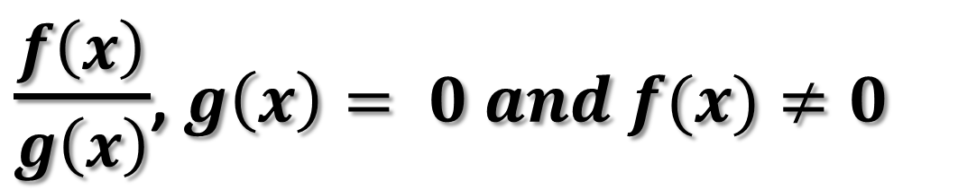
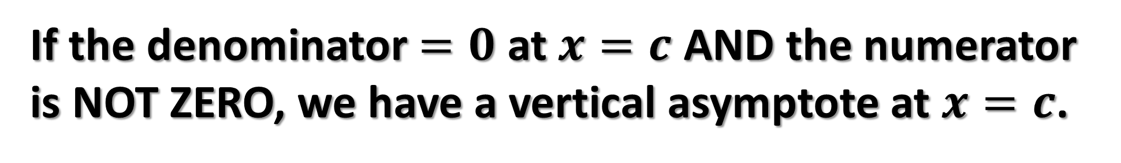
Theorem 1.14
Finding Vertical Asymptotes
If the denominator $=0$ at $x=c$ AND the numerator is NOT ZERO, we have a vertical asymptote at $x=c$.
$\frac{f\left(x\right)}{g\left(x\right)}$, $g\left(x\right)= 0 and f(x)≠0$

Slide 11
A Rational Function with Common Factors
When both the numerator and the denominator are both ZERO (Indeterminate Form),
  If Possible, Factor and Simplify (Section 1-3)
  If after factoring we still have indeterminate form, find one-sided limits by using a table and verify with graph

Slide 12







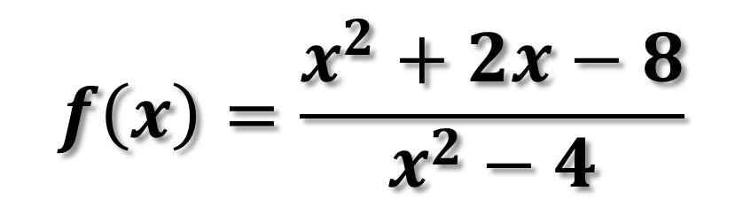





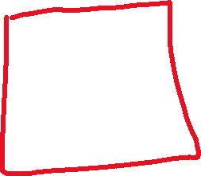










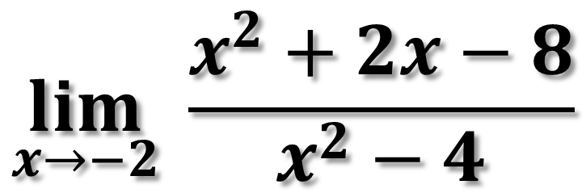
Ex. 6) Find any Vertical Asymptotes and the limit as $x→−2$
$$f\left(x\right)=\frac{x^{2}+2x−8}{x^{2}−4}$$
$$\lim_{x→−2}{ \frac{x^{2}+2x−8}{x^{2}−4}}$$

Slide 13
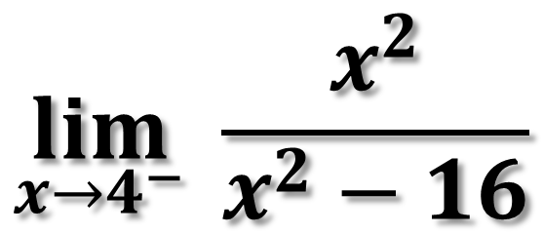
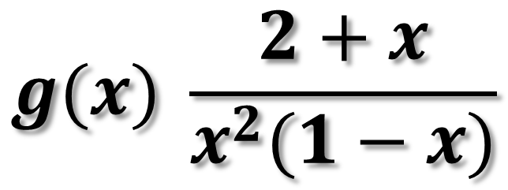
TRY THESE
Find the Vertical Asymptote
Find the Limit
$$\lim_{x→4^{−}}{ \frac{x^{2}}{x^{2}−16}}$$
$$g(x){ \frac{2+x}{x^{2}(1−x)}}$$

Slide 14
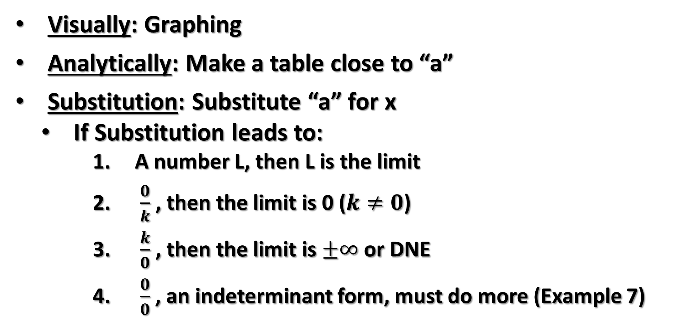
Methods for Finding Limits
Visually: Graphing
Analytically: Make a table close to “a”
Substitution: Substitute “a” for x
  If Substitution leads to:
      A number L, then L is the limit
      $\frac{0}{k}$ , then the limit is 0 ($k≠0$)
      $\frac{k}{0}$ , then the limit is $±∞$ or DNE
      $\frac{0}{0}$ , an indeterminant form, must do more (Example 7)

